Slide 1

Hand movement based device control
Guided By :
RAJESH M
MANOJ N
Presented By :
Mohammed Asad Rehman
Jagadishwar Pampad
National Institute of Electronics & Information Technology, Calicut.

Slide 2
OBJECTIVES
Controlling devices by using natural hand movement commands.
Control AC devices.
Control Computer.

Slide 3
SCOPE
Completely replace button based controls.
Give a feeling of controlling things naturally.

Slide 4
FEATURES
Natural controls.
Small size.
Wireless.
Vibrator feedback.
Can be made to control any remotely operated device.

Slide 5
BLOCK DIAGRAM

Slide 6
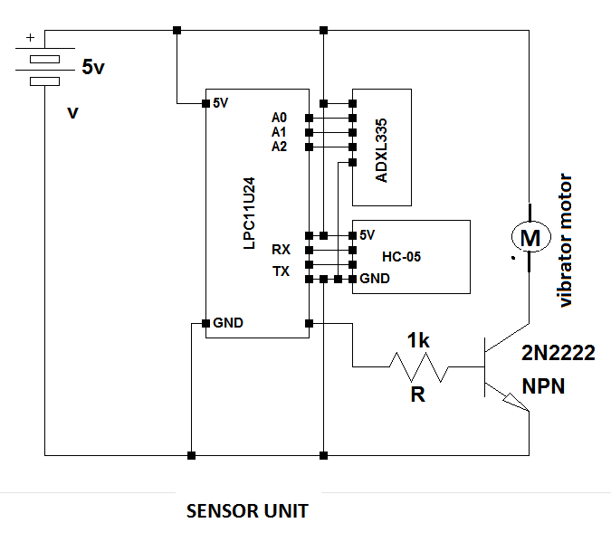
CIRCUIT DIAGRAM

Slide 7
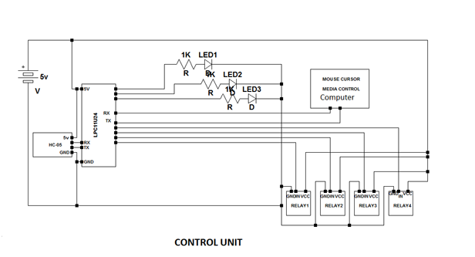

Slide 8

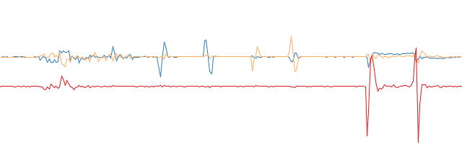
Accelerometer values

Slide 9

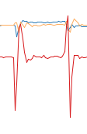

Accelerometer values
Moving
Left And Right
Moving
Forward and Backward
Moving
Up and down

Slide 10
Firmware
Pairing Indicator
Shake to turn on and off detection
Single button three control feature
8 bit word statement control
Movement detection: orientation and directional.
Vibrator feedback
Serial data controls python based mouse and media.

Slide 11
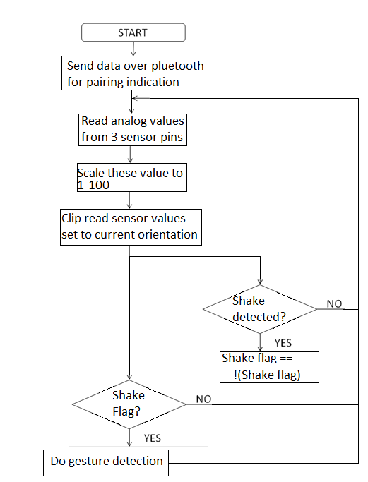
FLOW CHART
Sensor Unit

Slide 12
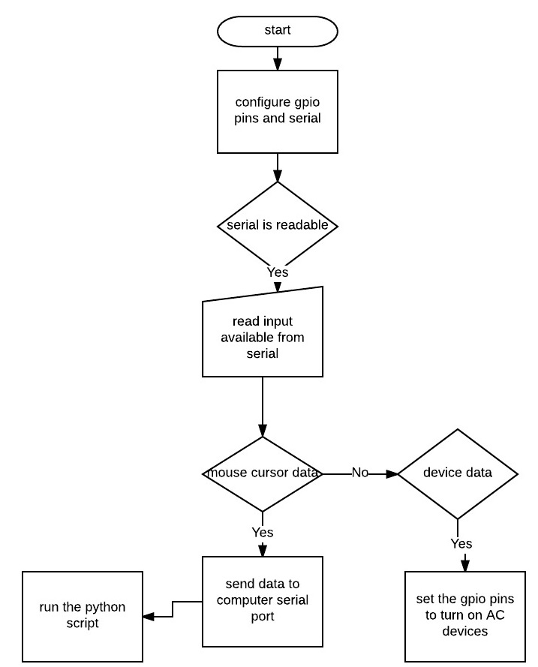
FLOW CHART
Control Unit

Slide 13
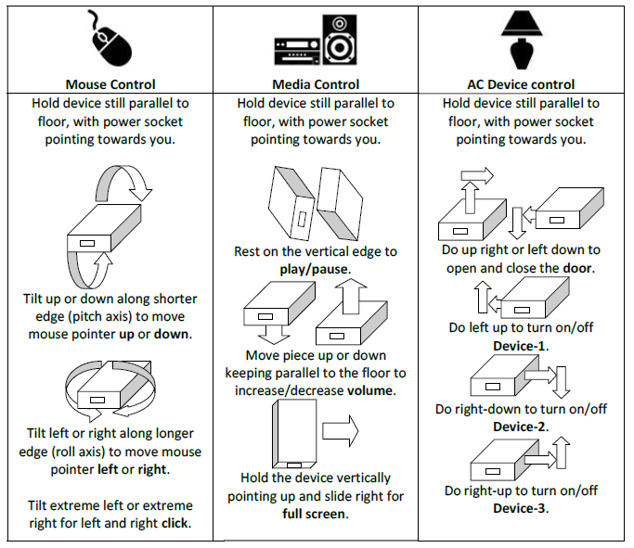
Controls

Slide 14
CONCLUSION
The project was implemented successfully. Three AC devices and various computer functionalities were controlled using hand gestures.

Slide 15
FUTURE SCOPE
Replacement for button remotes.
Wearable device.
Sensory fusion with gyroscope and magnetometer.
Measuring Cartesian coordinates.
Complete media centre PC control solution.

Slide 16
THANK YOU

